Slide 1
Capstone Project
Book Recommended System SELF PROJECT BY IRSHAD

Slide 2
Data Prepration
1.Defining the problem statement
2.EDA and feature engineering
3.Feature selection
4.Preparing Dataset for modelling
5.Applying model
6.Model selection and Validation

Slide 3
DATA SUMMARY
In the book recommended system the data is present in the three parts
Book Data
In the book data there is some features present in the data set like
1.Book publisher name
2.Book author name ,
3.Year of published,
4.Book title ,
5.Image URL of the book
User Data
In the user data there is some features present in the dataset which is represent the user
Like
1.User id
2. Location
3. Age

Slide 4
DATA SUMMARY
RATINGS
In the ratings data there is three features present in the rating data
1.ISBN
2.User id
3.Rating
ISBN – ISBN is the code of the book which is also present in the book data
User id- User id are given to those person who read the book once and they also gave some rating on that particular book
Rating – It is given by the person whose user id present in the book data as well with the help of this ratings other person can easily evaluate those books which is to be readable or not

Slide 5
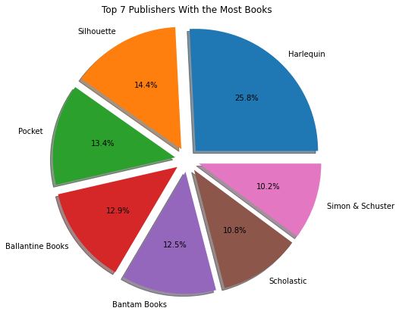
EDA(Exploratory Data Analysis)
This pie chart represent the top seven Publishers who Publishes most books

Slide 6
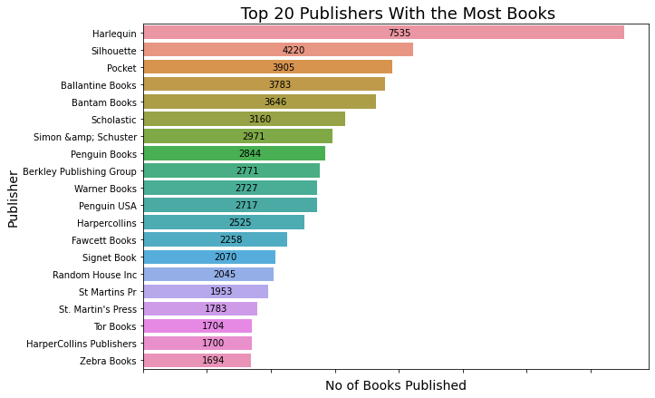
EDA(Exploratory Data Analysis)

Slide 7
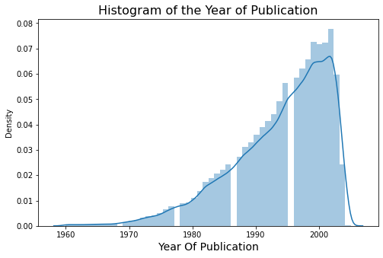
EDA(Exploratory Data Analysis)
Make a graphs which show the year of publication the books

Slide 8
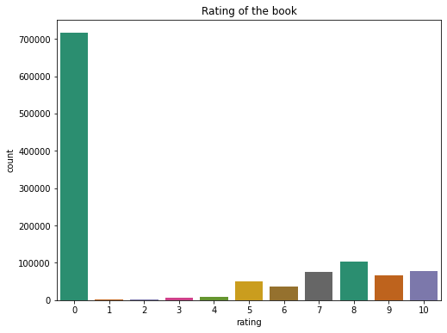
EDA(Exploratory Data Analysis)
Rating the books by the users

Slide 9
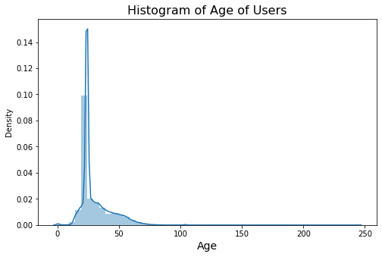
EDA(Exploratory Data Analysis)
Histogram of Age of Users

Slide 10
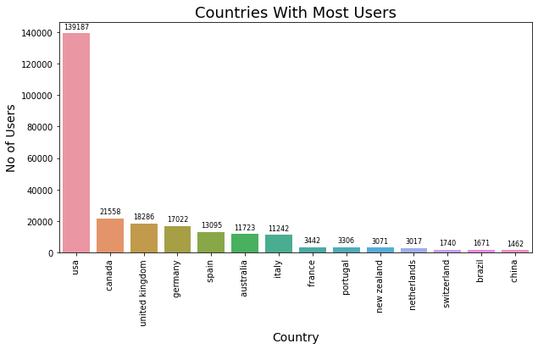
EDA(Exploratory Data Analysis)
COUNTRIES WITH MOST USERS

Slide 11
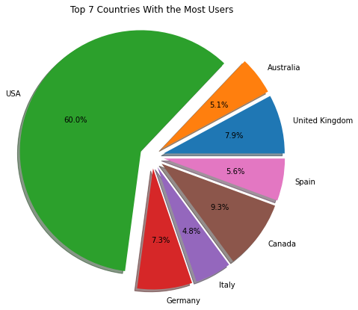
EDA(Exploratory Data Analysis)
Pie chart countries with most users

Slide 12
EDA(Exploratory Data Analysis)
Finally merge all the three data together
1.Extract important columns from the Books data
2. Rename the columns name of the user data
3. Rename the columns name of the book data
4. Count those user id of the book whose ratings are more than 200
5. Merge the rating data into book data on ISBN its gives only those book which is present in the data after merge

Slide 13
EDA(Exploratory Data Analysis)
In the final data there are some columns are:
1.User id
2.ISBN
3.RATING
4.TITLE
5.NUMBER OF RATING
6.AUTHOR
7.YEAR
Count only those books whose rating is more than 50
Drop the dublicates from the data set

Slide 14
Simple Book Recommendation System
Mainly three types of recommendation systems
1. Content Filtering:
In this algorithm, we try finding items look alike. Once we have item look like matrix , we can easily recommend alike items to a customer, who has purchased any item from the store.
2. Collaborative Filtering:
Here, we try to search for look alike customers and offer products based on what his/her lookalike has chosen .This algorithm is very effective but takes a lot of time and resources.
3. Hybrid Filtering (Content Filtering + Collaborative Filtering):
Both Content Filtering & Collaborative Filtering is used for the purpose. you-tube uses this algorithm for their strong recommendation system.

Slide 15
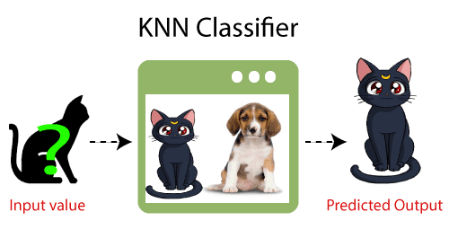
KNN ALGORITHM
K-NN algorithm stores all the available data and classifies a new data point based on the similarity. This means when new data appears then it can be easily classified into a well suite category by using K- NN algorithm.

Slide 16
CONCULSION
This is the final recommendation of the books we input one book name then its give the 5 recommended books to read
This book provides an introduction to recommender systems. In the context of ever-increasing amounts of available information and data, it is difficult to know what information to look for and where to look for it. Computer-based techniques have been developed to facilitate the search and retrieval process; one of these techniques is recommendation, which guides users in their exploration of available information by seeking and highlighting the most relevant information.
Recommender systems have their origins in a variety of areas of research, including information retrieval, information filtering, text classification, etc. They use techniques such as machine learning and data mining, alongside a range of concepts including algorithms, collaborative and hybrid approaches, and evaluation methods.

Slide 17
Naive baye’s
Precision Recall f1-score Support
0.89 0.15 0.26 7000
0.24 0.94 0.38 2000
Accuracy 0.33 9000
Macro Avg 0.57 0.55 0.32 9000
weighted Avg 0.75 0.33 0.29 9000
Gaussian Naive Bayes model accuracy is 32.79%

Slide 18
Decision tree
Precision Recall f1-score Support
0.89 0.15 0.26 7000
0.24 0.94 0.38 2000
Accuracy 0.33 9000
Macro Avg 0.57 0.55 0.32 9000
weighted Avg 0.75 0.33 0.29 9000
The accuracy score of Decision tree is 68.44%

Slide 19
Random forest classifier
Precision Recall f1-score Support
0.89 0.15 0.26 7000
0.24 0.94 0.38 2000
Accuracy 0.33 9000
Macro Avg 0.57 0.55 0.32 9000
weighted Avg 0.75 0.33 0.29 9000
The accuracy score of random forest is 78.2%

Slide 20
0.
Hyper parameter tuning on random forest algorithm
Precision Recall f1-score Support
0.86 0.83 0.85 7000
0.48 0.53 0.50 2000
Accuracy 0.77 9000
Macro Avg 0.67 0.68 0.67 9000
weighted Avg 0.78 0.77 0.77 9000
The accuracy score of random forest is 76.69%

Slide 21
Conclusion:
Using a Random Forest classifier, we can predict with ~78.2%. accuracy, whether a customer is likely to default next month.
The strongest predictors of default are the PAY_X (ie. the repayment status in previous months), the LIMIT_BAL & the PAY_AMTX (amount paid in previous months).
Demographics: we see that being Female, More educated, Single and between 30-40years old means a customer is more likely to make payments on time.

